Slide 1
Supervised Learning Capstone
Andrew Barreiros • 10.7.2019

Slide 2
Overview
Data Exploration
Data
Github
Feature Creation via NLP
Modeling
KNN, Naive Bayes, Random Forest

Slide 3
Data Exploration

Slide 4
Data Exploration - Questions
What are the most largely produced varieties? Highest price? Highest reviewed?
Which countries and regions produce the largest quantities of wine? Highest priced? Highest reviews?
What are the most common descriptor words in the reviews?
Which tasters have reviewed the most wine? What is the range within which their reviews fall?
What years were the majority of the bottles produced? How does bottle year affect the price and points?

Slide 5
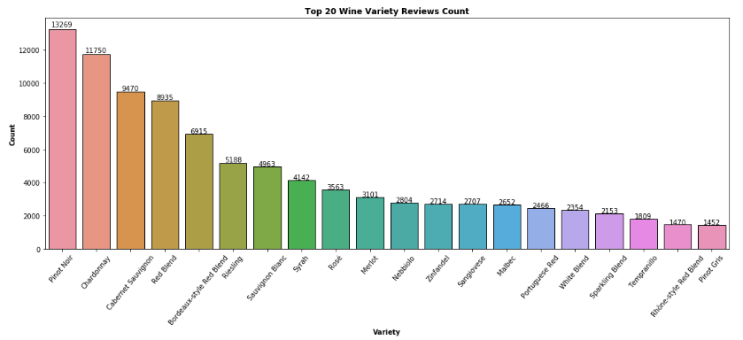
Data Exploration - Variety
Key Items Noted:
701 Unique Varieties
335 Varieties 5 or Less
Top 3 - 26.55 % of Pop.
Rose - Cheapest / Lowest Score

Slide 6
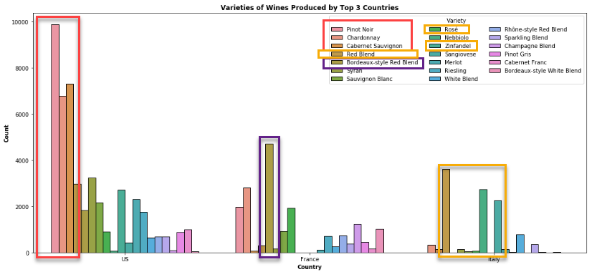
Data Exploration - Countries

Slide 7
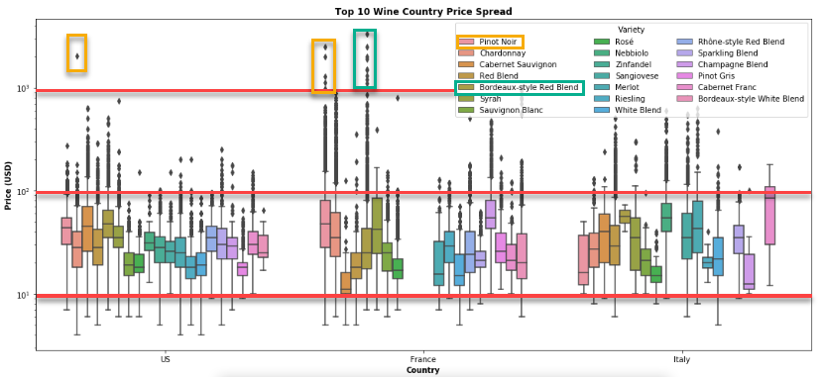
Data Exploration - Variety

Slide 8
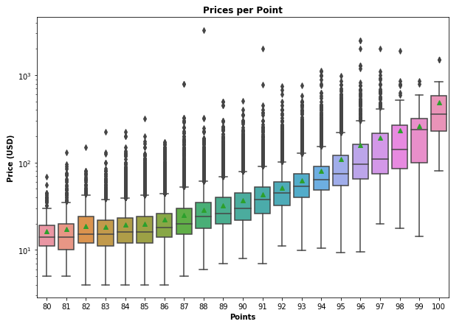
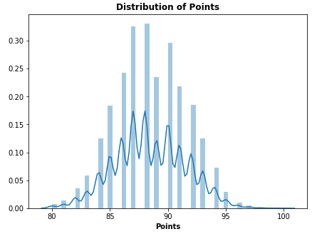
Data Exploration - Points

Slide 9
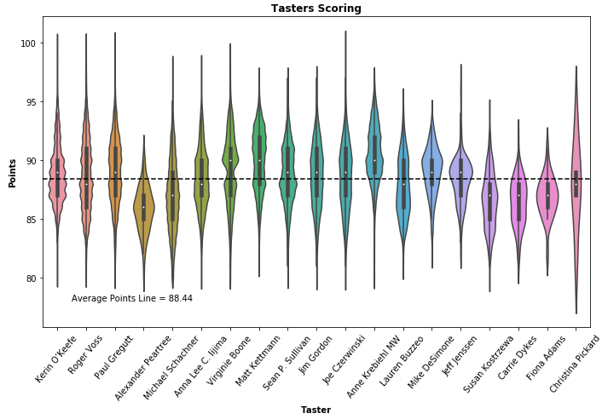
Data Exploration - Tasters
Key Items Noted:
19 Tasters
Average Points 88.44

Slide 10
Natural Language Processing

Slide 11
Attention areas
Year
Pulled from Bottle Title via isdigit
NANs filled by mean of population
Tasting Notes
Cleaned via Several Functions
Stop Words Removed
Count Vectorizer to Extract Top 100 Keywords
Single, Bi, and Tri-grams Identified

Slide 12
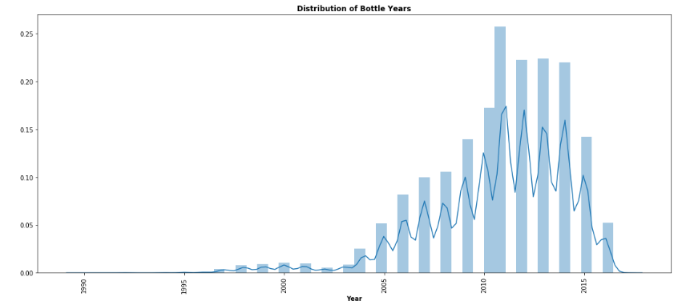
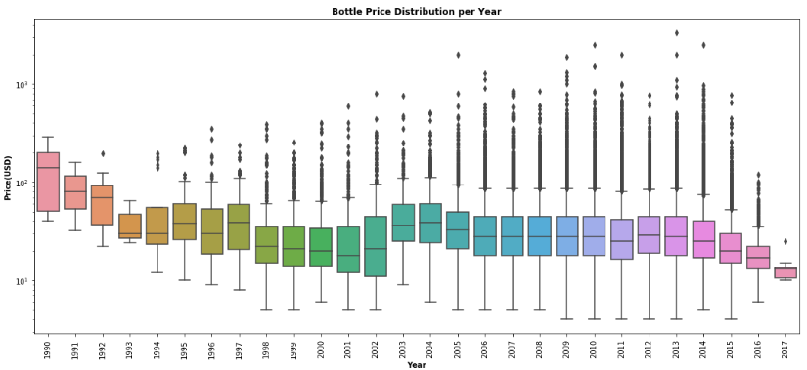
NLP - Years

Slide 13
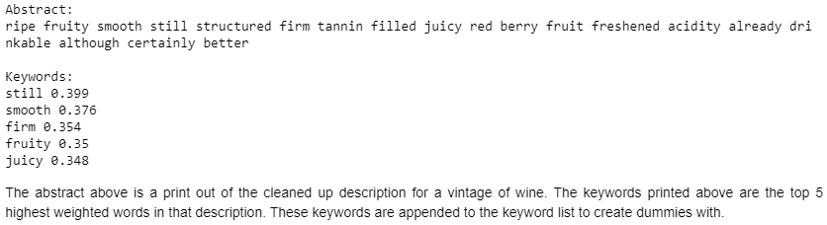
Data Exploration - Variety
Keywords Usage:
Keywords used as features in modeling
Goal is to use keywords to identify specific varieties

Slide 14
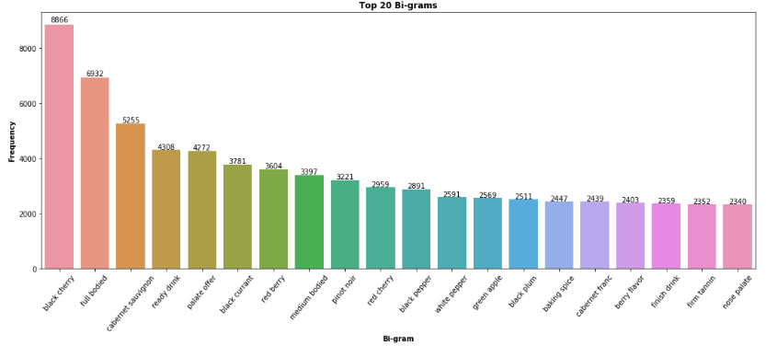
NLP - Tasting Notes

Slide 15
Models

Slide 16
Model Business Use
Can help introduce users to new varietals
A winery can use as recommendation engine for bottles

Slide 17
N_neighbors = 10
Weights = ’distance’
Train Accuracy = 99.9%
Test Accuracy = 51.8%
Defaults Used
Train Accuracy = 99.3%
Test Accuracy = 54.4%
1. KNN
2. Naive Bayes
3. Random Forest
Defaults Used
Train Accuracy = 55.3%
Test Accuracy = 53.2%

Slide 18
Next steps
Top 20 Varieties
Noted that half of varieties only had 5 or less samples
Model could be skewed towards higher sampled varieties
Oversampling
Pinot Noir(1) had 10x number of samples as Pinot Gris(20)
Duplicate samples of lower varieties
Hyperparameters
Maximize the results of each individual parameter

Slide 19
Defaults Used
Train Accuracy = 99.3%
Test Accuracy = 71.6%
Parameters Next Slide
Train Accuracy = 99.9%
Test Accuracy = 97.4%
4. Top 20 Varieties
5. Oversampling
6. Hyperparameters
Defaults Used
Train Accuracy = 99.9%
Test Accuracy = 96.8%

Slide 20
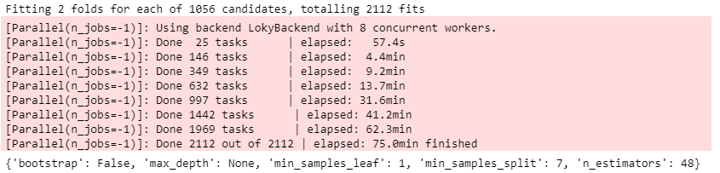
Hyperparameters

Slide 21
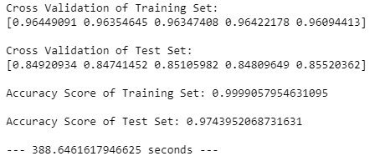
Hyperparameters - Results
Results:
Model is excellent variety classifier
Downside: Long runtime when considering model 5

Slide 22
Model Weak Points
Solutions
Higher samples of varietals
Shorten Run Time

